Slide 1
TCP on Tokamak Programmes (CTP TCP)
Shun Ide-san
24-25 January 2024, IEA FUSION POWER CO-ORDINATING COMMITTEE (FPCC)

Slide 2
Outline
Membership
Meetings
Participation of the private sector
CICLOP: A Joint Task of the Co-operation between CTP and SH
Highlights

Slide 3
Membership
CTP TCP has 9 Contracting Parties (CPs)4 IEA member countries:
Australian Nuclear Science and Technology Organisation (ANSTO), Australia
National Institutes for Quantum and Radiological Science and Technology (QST), Japan
Korean Ministry of Education, Science and Technology (MEST), Korea
United States Department of Energy (USDOE), United States
Ecole polytechnique fédérale de Lausanne (EPFL), Switzerland
1 partner country:
The Institute for Plasma Research (IPR), India
4 International Organizations:
European Atomic Energy Community (Euratom), European Union
ITER China Domestic Agency (CNDA)
ITER Organization

Slide 4
Membership
Switzerland joined the CTP TCP officially as a Contracting Party on 18th October 2022 and the nominated representatives from Switzerland are Ambrogio Fasoli and Paolo Ricci.
The IEA CTP TCP Executive Committee approved by the written procedure ending on 31st August 2022 to invite the Government of United Kingdom to join the CTP TCP as a Contracting Party.
Exchanges between IEA and the United Kingdom Government are ongoing and the United Kingdom have informed the IEA in January 2024 that clearance have been received to proceed with the membership process in order to join the CTP, ESEFP, FM, NTFR, PWI and ST TCPs. The IEA are still waiting to receive the formal paperwork, but the process should be completed soon.

Slide 5
Meetings
14th Executive Committee Meeting at the ITER Organisation Headquarters, St. Paul-lez-Durance, France, Thursday 20th December 2023
26th meeting of the International Tokamak Physics Activity Coordinating Committee (ITPA CC) and 14th ITPA meeting for Joint Experiments at the ITER Organisation Headquarters, St. Paul-lez-Durance, France, 18th-20th December 2023

Slide 6
Participation of the private sector
At the 26th ITPA Coordinating Committee (ITPA CC) and the 14th CTP TCP Executive Committee meeting, the US communicated the interest of private companies to have the option to be involved in the ongoing CTP activities, such as the International Tokamak Physics Activities (ITPA).
The modernization of the IEA CTP Implementation Agreement put in place the "limited sponsor" framework.

Slide 7
Participation of the private sector
The "limited sponsor" framework is a streamlined procedure for involvement by a non-contracting party in one the TCP workstream for a period of less than three years.
The US suggested to the ITPA Coordinating Committee that a working group be formed to establish an explicit procedure to facilitate private sector involvement in the ITPA.
The CTP TCP Executive Committee agreed to follow up the outcome of the Working Group and explore the possibilities within the CTP TCP for utilising the “limited sponsor” framework.

Slide 8
CICLOP: A Joint Task of the Co-operation between CTP and SH
The IEA TCP CTP Executive Committee agreed to establish initially the CICLOP Joint Task including the parties that are members of both TCPs (CTP and SH), i.e. initially without the full participation of Korea with observer status and proposed to discuss in the meanwhile the options available to fully involve Korea as soon as possible.

Slide 9
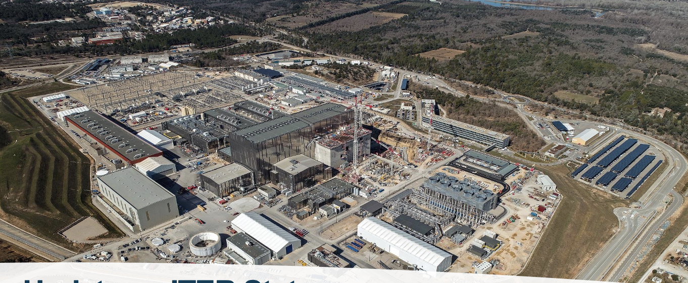
Highlights
The ITER project has continued making steady progress towards first plasma with most plant support systems now in the commissioning phase.

Slide 10
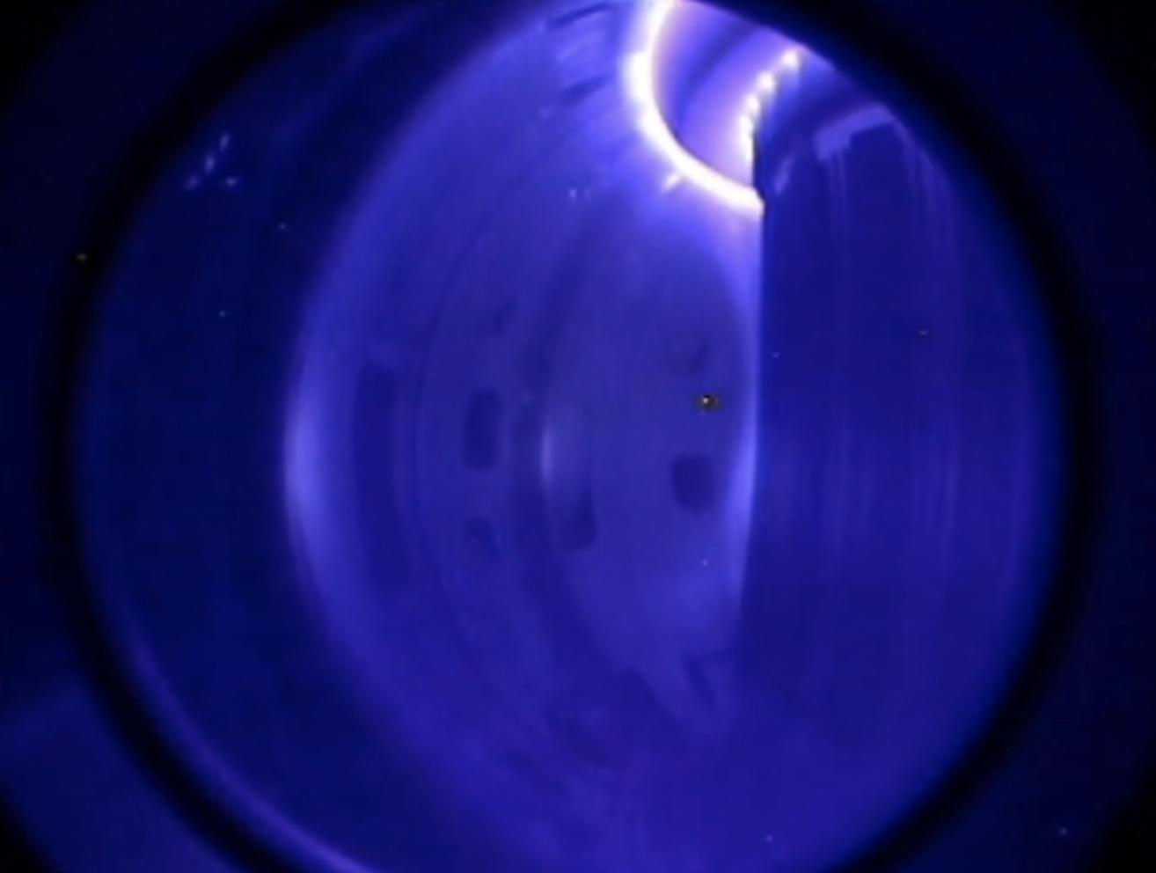
Highlights
Integrated Commissioning of JT-60SA, a large super-conducting tokamak, resumed on May 2033.
The first tokamak plasma of 130 kA was achieved in JT-60SA on 23rd November 2023.
And in the following days a diverted plasma of 1.2 MA was achieved.
The knowledge on wall conditioning/ tokamak plasma start-up with low break-down voltage etc., will contribute to ITER.

Slide 11
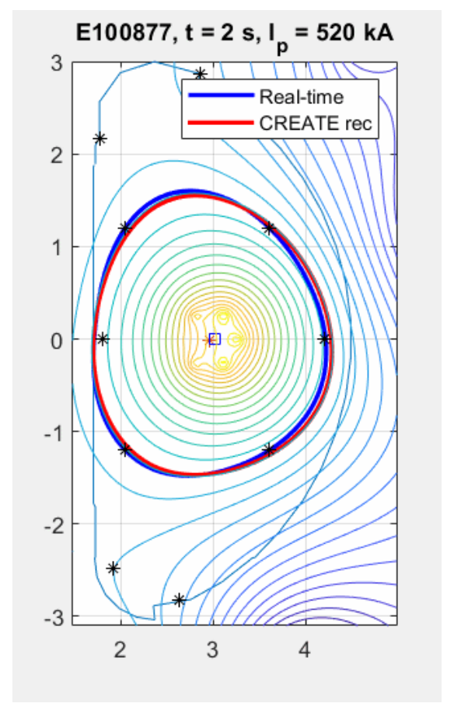
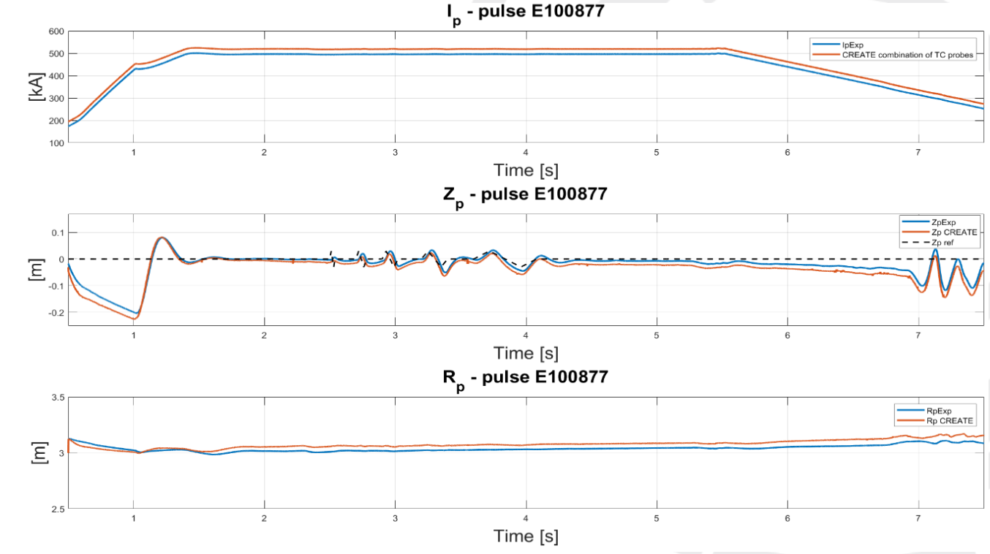
Highlights
Plasma boundary and 𝑹𝒑, 𝒁𝒑 and 𝑰𝒑 reconstruction
Joint activities for comparison between equilibrium reconstruction with Japanese and European codes shows a similar behaviour of the plasma shape and centroid evolution on JT-60SA first plasma experiments.

Slide 12
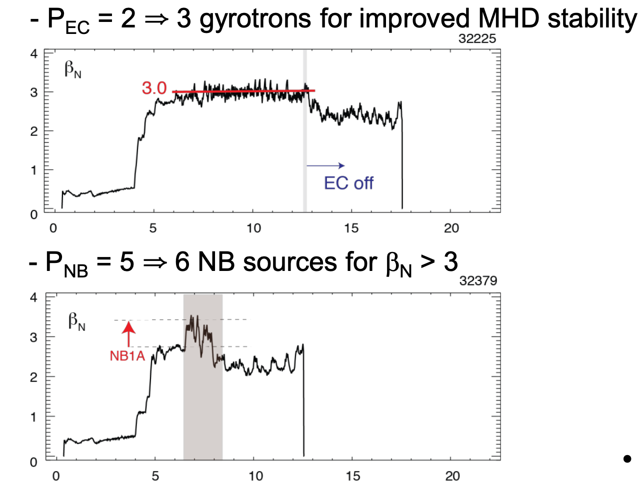
Highlights
In KSTAR, operation at β_{N} > 3 was achieved for 15 seconds with fully non-inductive operation in the upper single null carbon divertor and for 50 seconds in the lower single null tungsten divertor.
Plasma operation at β_{N} > 3 using different auxiliary heating schemes

Slide 13
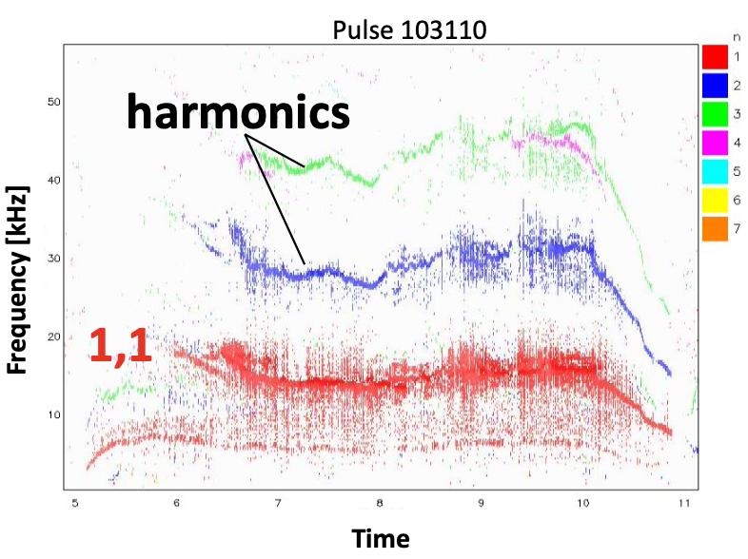
Highlights
Joint experiments on JET with high beta long pulse scenarios observed for the first-time flux-pumping following on the previous results obtained at the ASDEX Upgrade tokamak.
MHD activity spectrogram showing the (1,1) mode that regulates the evolution of the q profile

Slide 14
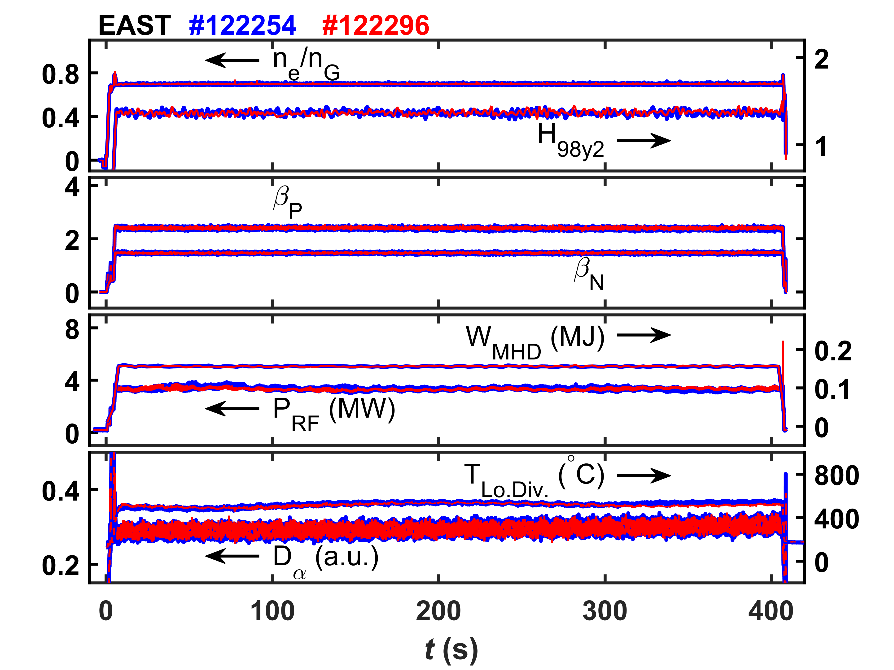
Highlights
Repeatable high-performance plasmas achieved in EAST with duration of 403 seconds with the Tungsten Divertor, fully non-inductive plasma with dominant electron heating with no injected torque, good confinement properties, grassy Edge Localised Modes with frequency above 2.5kHz and stationary divertor temperature.

Slide 15
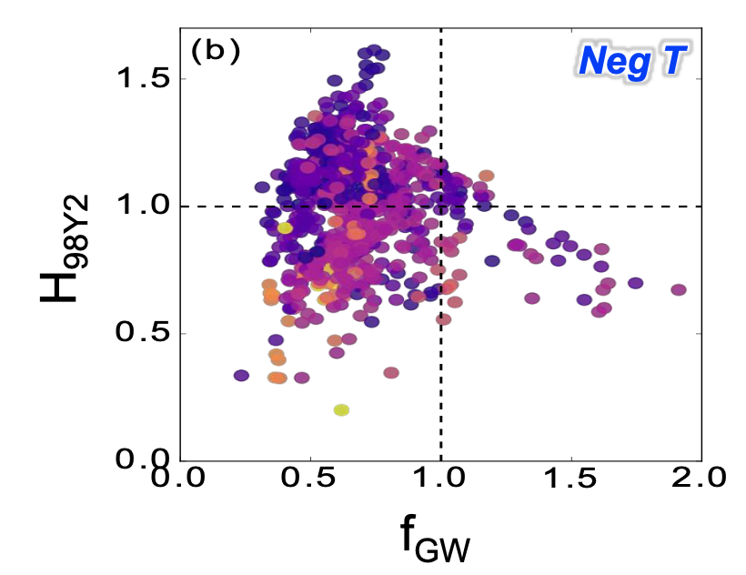
Highlights
DIII-D completed in 2023 a 40-week run period with many results obtained during a negative triangularity campaign. Key results in preparation of ITER include operation at low power compared with the power required for the L-H transition.
Operation in DIII-D with negative triangularity plasmas in terms of the Greenwald density limit fraction and confinement quality as compared with the H₉₈ scaling

Slide 16
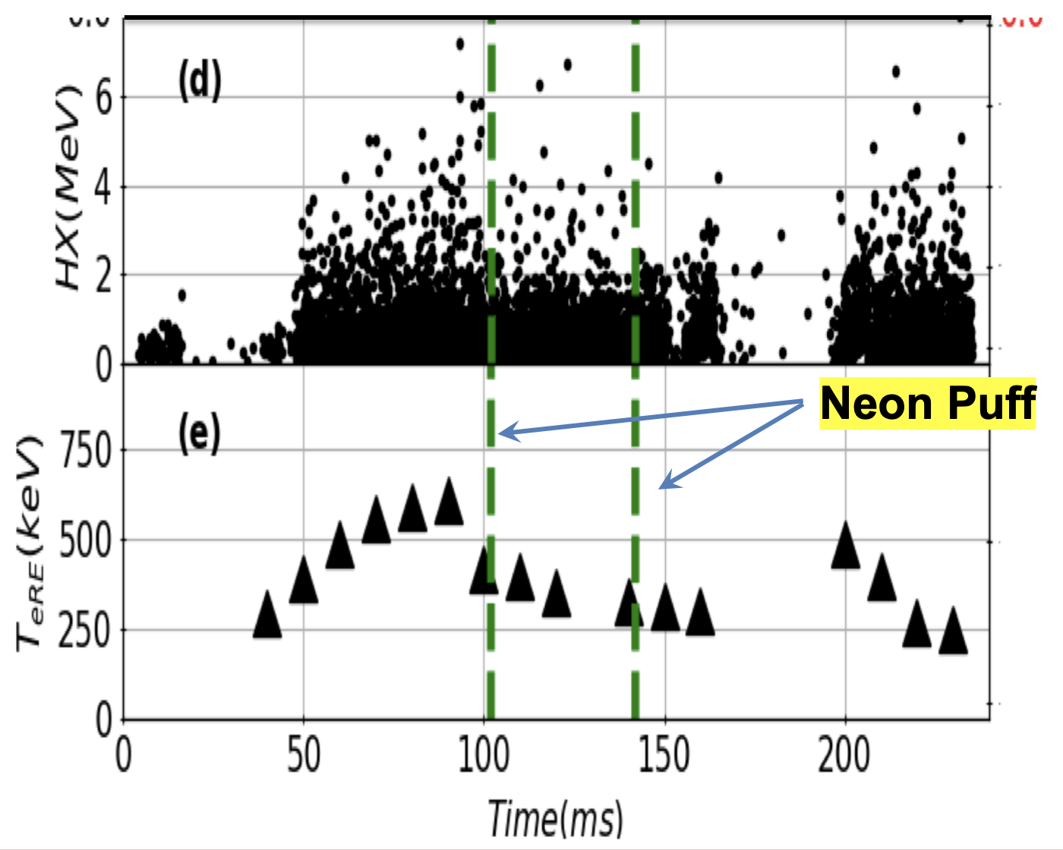
Highlights
ADITYA-UG experiments include runaway mitigation by Neon impurity seeding as the Neon puffing increases the electron density which increases the required Dreicer electric field substantially reducing the runaway electron energy.
Hard x-ray energy and electron runway beam energy as a function of time showing the effect of the Neon gas puff

Slide 17
Thank you for your attention

